Slide 1

Advanced Corporate Finance (LL4554V/LL5554V/LLJ5554V/LL6554V) 10. understanding options
Kenneth Khoo
kenneth.khoo@nus.edu.sg

Slide 2
Today’s Roadmap
Calls and Puts (Ch. 21-1)
Call and put options: definitions, payoffs, and profit
American vs. European options
Payoff diagrams vs. profit diagrams
Selling (writing) calls and puts
Financial Engineering with Options (Ch. 21-2)
Downside protection with puts and calls
Put-call parity
Replicating payoffs and the replication principle
What Determines Option Values? (Ch. 21-3)
Upper and lower bounds on option value
Five determinants of option value
Why volatility increases option value

Slide 3
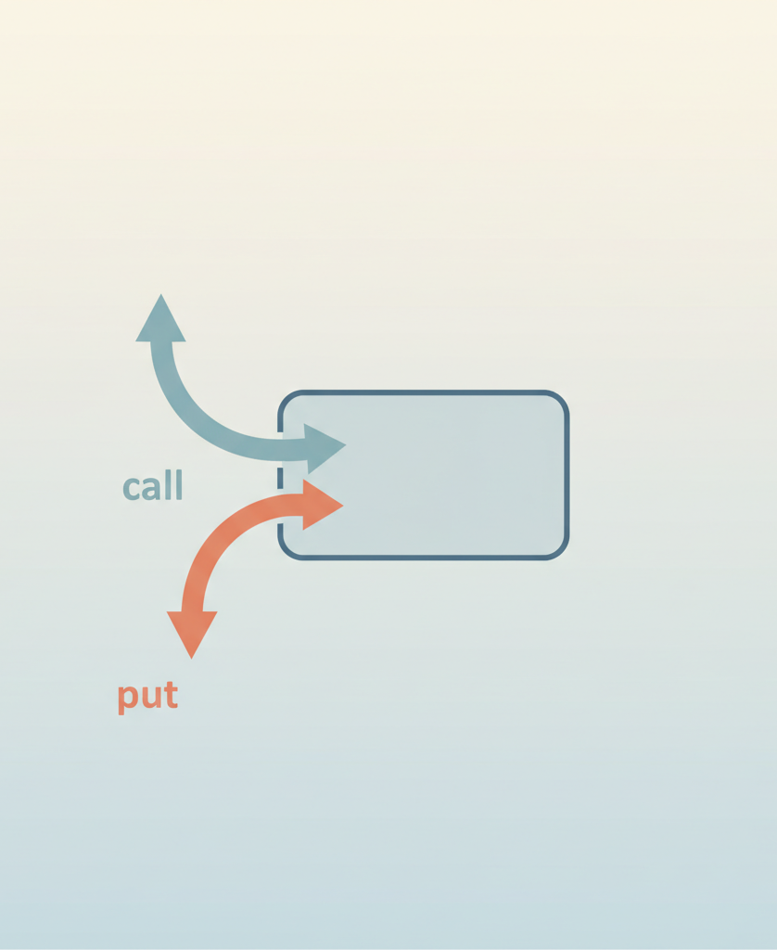
What Is an Option?
An option gives its owner the right, but not the obligation, to buy or sell an asset at a pre-specified price
Options are derivative instruments: their payoff is derived from the price of the underlying asset (usually a stock)
Two basic types:
Call option: right to BUY at the exercise (strike) price
Put option: right to SELL at the exercise (strike) price
American option: can be exercised on or before the maturity date
European option: can be exercised only at the maturity date
These terms imply nothing about geography — European options trade in the US and vice versa
Notes:
Call option: What is owed if exercised?
The Seller owes you: The shares of the underlying stock.
You owe the Seller: The cash equivalent of the strike price.
Where do the shares come from? The burden of sourcing the shares falls entirely on the seller. There are two ways this happens:
Covered Call: The seller already owns the underlying shares in their brokerage account. When you exercise the option, their broker automatically transfers those existing shares to you.
Naked Call: The seller does not own the shares. When you exercise the option, the seller is legally obligated to buy the shares on the open market at the current (higher) market price, and immediately sell them to you at the lower, agreed-upon strike price. Because a stock's price can theoretically rise infinitely, selling naked calls carries unlimited risk.
Put Option: What is owed if exercised?
The Seller owes you: The cash equivalent of the strike price.
You owe the Seller: The underlying shares.
Where do the shares come from? Here, the burden of sourcing the shares falls on you, the option buyer.
Protective Put: You already own the shares in your portfolio. When you exercise the put, you deliver your shares to the seller, and they give you the cash.
Speculative Put: You don't actually own the underlying shares; you simply bought the put to bet against the stock. To exercise the option, you must first buy the shares on the open market at the current (lower) market price, and then immediately deliver them to the seller in exchange for the higher strike price

Slide 4
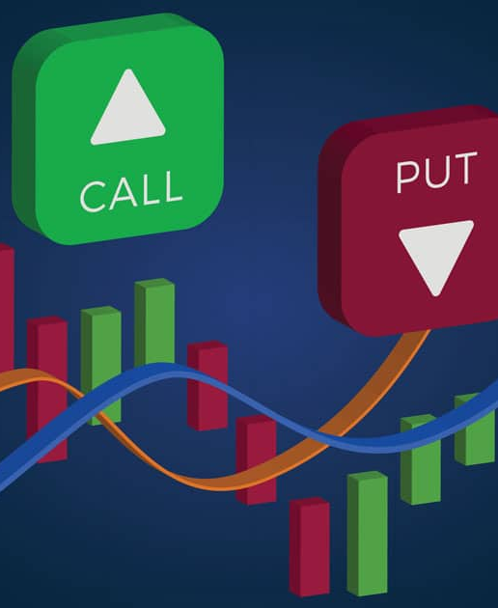
Call option: mechanics
Call option: What is owed if exercised?
The Seller owes you: The shares of the underlying stock.
You owe the Seller: The cash equivalent of the strike price.
Where do the shares come from? The burden of sourcing the shares falls entirely on the seller. Two ways:
Covered Call: The seller already owns the underlying shares in their brokerage account. When you exercise the option, their broker automatically transfers those existing shares to you.
Naked Call: The seller does not own the shares. When you exercise the option, the seller is legally obligated to buy the shares on the open market at the current (higher) market price, and immediately sell them to you at the lower, agreed-upon strike price. Because a stock’s price can theoretically rise infinitely, selling naked calls carries unlimited risk.

Slide 5
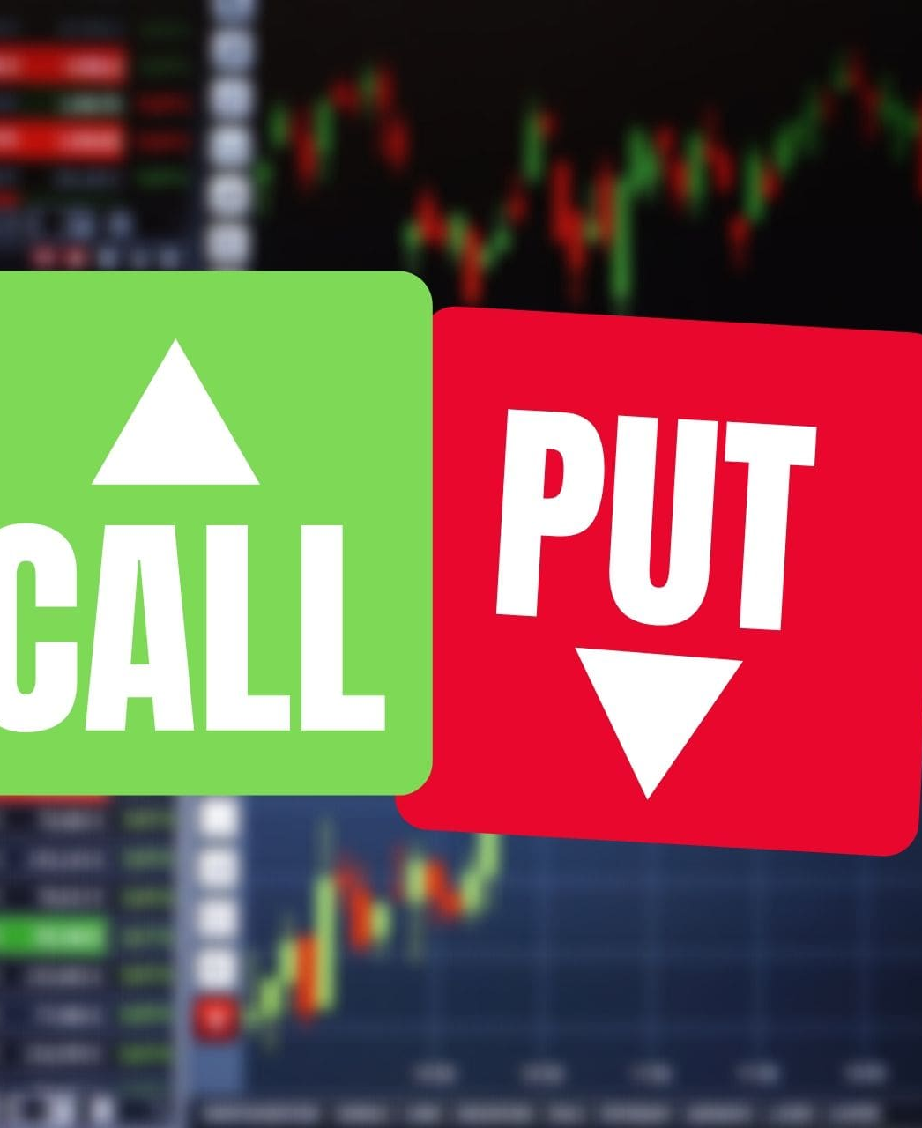
put option: mechanics
Put Option: What is owed if exercised?
The Seller owes you: The cash equivalent of the strike price.
You owe the Seller: The underlying shares.
Where do the shares come from? Here, the burden of sourcing the shares falls on you, the option buyer. Two ways:
Protective Put: You already own the shares in your portfolio. When you exercise the put, you deliver your shares to the seller, and they give you the cash.
Speculative Put: You don’t actually own the underlying shares; you simply bought the put to bet against the stock. To exercise the option, you must first buy the shares on the open market at the current (lower) market price, and then immediately deliver them to the seller in exchange for the higher strike price.

Slide 6
Why Financial Managers Need to Understand Options
Companies use commodity, currency, and interest-rate options to manage risk
Hershey buys options to cap future cocoa prices
Airlines buy options to cap jet fuel costs
Executive compensation frequently includes stock options
Shopify offers its CEO a bonus if stock exceeds $128 by March 2031
Corporate securities often embed options:
Convertible bonds give holders the option to exchange bonds for stock
Limited liability gives shareholders the option to walk away from debts
Real options arise in capital budgeting: option to expand, delay, or abandon projects
Understanding traded options is the foundation for all of these applications
NB: There is always a counterparty in an option contract. Q: Who are the counterparties here?

Slide 7
Reading Option Quotes: Amazon (Table 21.1)
Amazon share price: ~$140 in August 2023
Option prices depend on at least two factors:
1. Exercise price:
Nov 2023 call at $110: costs $33.25
Nov 2023 call at $130: costs $20.88 (higher X → lower call value)
Nov 2023 call at $150: costs $5.95
2. Time to maturity:
At X = $140: Nov call $10.45, Feb call $15.39, May call $17.50
Longer maturity → higher option value (more time for price to move favorably)
Options trade in multiples of 100 contracts

Slide 8
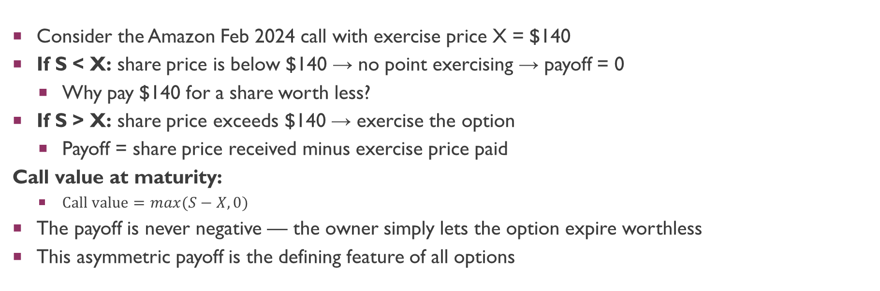
Call Option Payoff at Maturity
Consider the Amazon Feb 2024 call with exercise price X = $140
If S < X: share price is below $140 → no point exercising → payoff = 0
Why pay $140 for a share worth less?
If S > X: share price exceeds $140 → exercise the option
Payoff = share price received minus exercise price paid
Call value at maturity:
$\text{Call} \text{value}=max(S−X,0)$
The payoff is never negative — the owner simply lets the option expire worthless
This asymmetric payoff is the defining feature of all options

Slide 9
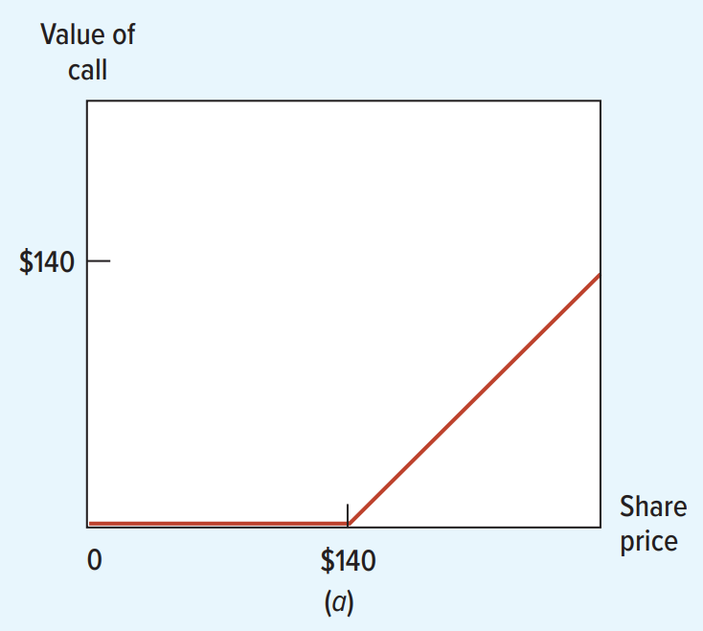
Payoff Diagram: Buying a Call
Exercise price X = $140
Below $140: option worthless
Above $140: payoff rises $1 for $1
Payoff = max(S – X, 0)
The kink at X creates the asymmetric payoff structure that makes options valuable
Notes:
Note: Payoffs are NOT PROFITS.

Slide 10
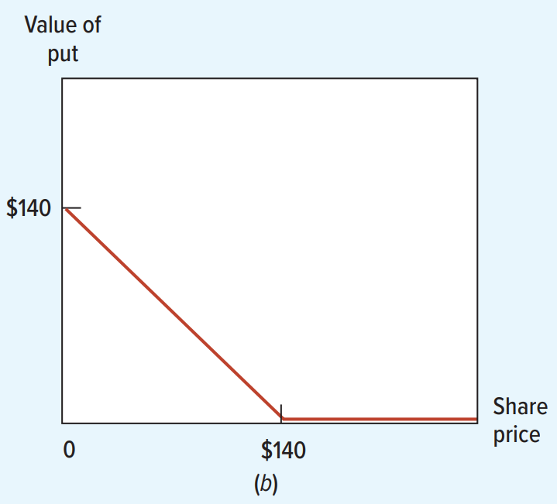
Payoff Diagram: Buying a Put
A put gives the right to SELL at the exercise price X = $140
If S > X: no point selling at $140
Payoff = 0
If S < X: buy share cheaply, sell at $140 via the put
Payoff = X – S
Put value = max(X – S, 0)

Slide 11

Moneyness of an Option
Moneyness describes whether exercising the option now would produce a positive payoff
In the money: exercising now gives a positive payoff
Call: S > X (e.g., Amazon calls with X < $140 were in the money)
Put: S < X
At the money: S = X, payoff would be zero
Amazon calls with X = $140 were at the money
Out of the money: exercising now gives a negative payoff (so you would not exercise)
Call: S < X (e.g., Amazon calls with X > $140 were out of the money)
Put: S > X
An option’s moneyness changes as the stock price moves

Slide 12
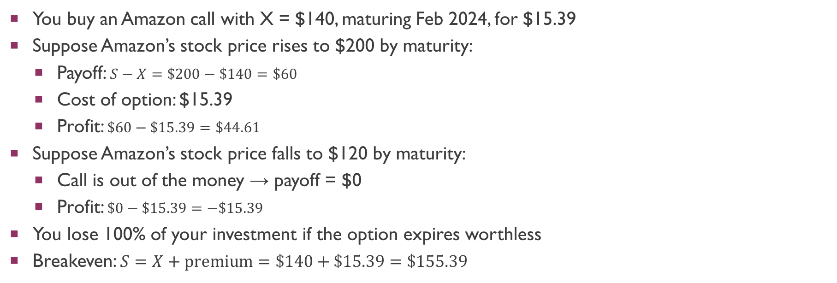
Profit from Buying a Call (Example 21.1)
You buy an Amazon call with X = $140, maturing Feb 2024, for $15.39
Suppose Amazon’s stock price rises to $200 by maturity:
Payoff: $S−X=\$200−\$140=\$60$
Cost of option: $15.39
Profit: $\$60−\$15.39=\$44.61$
Suppose Amazon’s stock price falls to $120 by maturity:
Call is out of the money → payoff = $0
Profit: $\$0−\$15.39=−\$15.39$
You lose 100% of your investment if the option expires worthless
Breakeven: $S=X+\text{premium}=\$140+\$15.39=\$155.39$

Slide 13
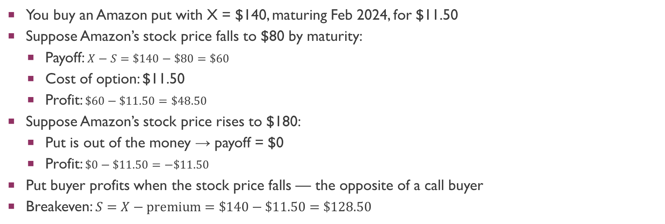
Profit from Buying a Put (Example 21.2)
You buy an Amazon put with X = $140, maturing Feb 2024, for $11.50
Suppose Amazon’s stock price falls to $80 by maturity:
Payoff: $X−S=\$140−\$80=\$60$
Cost of option: $11.50
Profit: $\$60−\$11.50=\$48.50$
Suppose Amazon’s stock price rises to $180:
Put is out of the money → payoff = $0
Profit: $\$0−\$11.50=−\$11.50$
Put buyer profits when the stock price falls — the opposite of a call buyer
Breakeven: $S=X−\text{premium}=\$140−\$11.50=\$128.50$

Slide 14
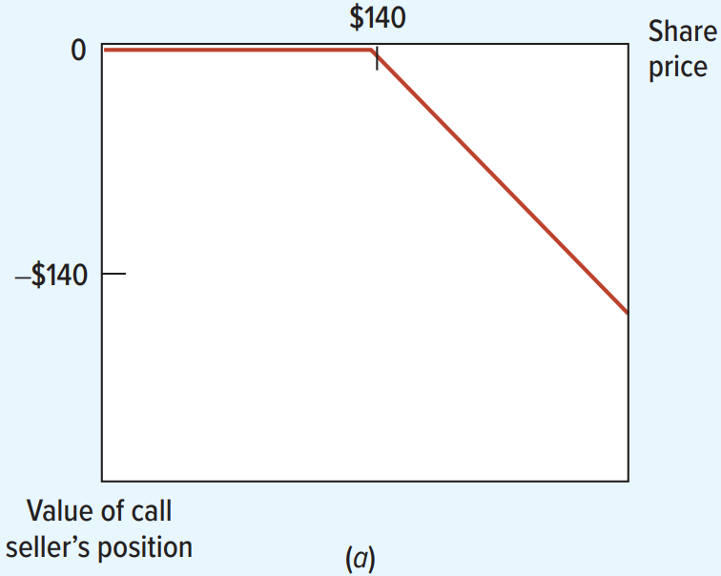
Selling (Writing) a Call Option
Options are side bets between two investors: buyer and seller
For a call option, the seller (writer) must deliver shares if the buyer exercises
If S < X: buyer won’t exercise, seller’s liability is zero
If S > X: seller loses S – X
Seller’s payoff = –max(S–X, 0)
Mirror image of buyer’s payoff

Slide 15
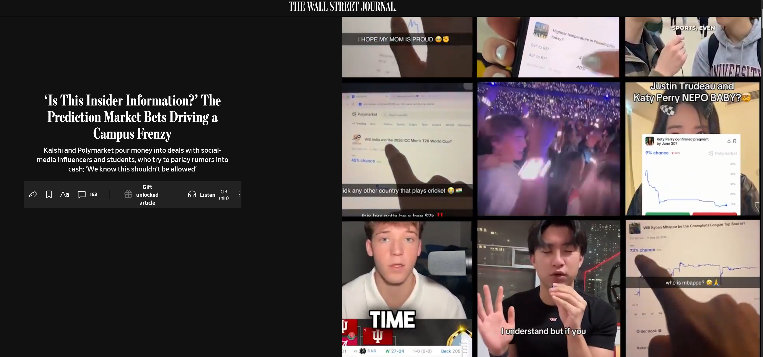
Prediction Markets as Binary Options (Polymarket, Kalshi)
https://www.wsj.com/business/media/prediction-markets-campus-e57cd19f
Prediction markets are fundamentally structured as binary options—one person’s gain is another person’s loss. Polymarket takes a cut via transaction fees.

Slide 16
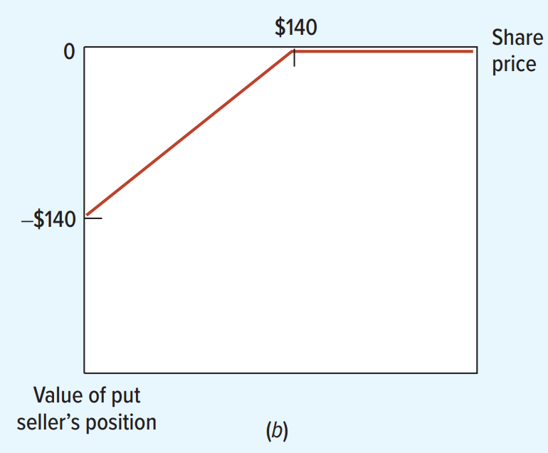
Selling (Writing) a Put Option
Seller agrees to buy the share at X = $140 if buyer exercises
If S > X: buyer won’t exercise, seller’s liability is zero
If S < X: seller must pay $140 for a share worth less
Worst case: stock goes to $0, seller loses $140
Seller’s payoff = –max(X–S, 0)

Slide 17
Counterparty Risk in Options
For every option buyer there is a seller — the buyer’s gain is the seller’s loss
The buyer of any option (calls and puts) bears counterparty risk:
If the option ends up in the money and the buyer exercises, the seller must pay
If the seller is bankrupt, the buyer may not receive what is owed
Exchange-traded options reduce this risk through a clearinghouse that guarantees performance
Key insight: the buyer’s payoff (not profit!) is always non-negative; the seller’s is always non-positive
It is the option buyer who always has the option to exercise — sellers simply do as they are told

Slide 18
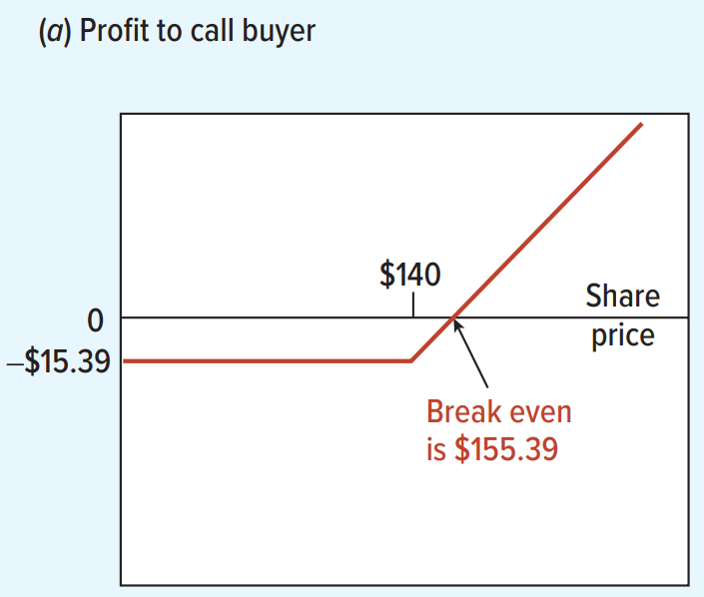
Payoff Diagrams vs. Profit Diagrams
Payoff diagrams: show value at maturity only (ignoring cost)
Profit diagrams: subtract initial option cost from the payoff
Call buyer breakeven: S = $140 + $15.39 = $155.39
Payoff diagram makes a call look like a sure thing — profit diagram corrects this

Slide 19
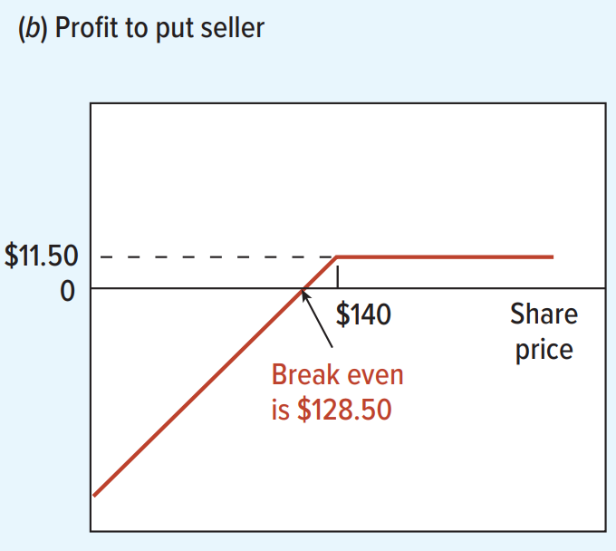
Profit Diagram: Selling a Put
Selling a put looks like a sure loss in the payoff diagram
But the seller received $11.50 upfront from selling the put
Seller gains at prices above: S = $140 – $11.50 = $128.50
Profit diagram adds back the $11.50 premium received

Slide 20
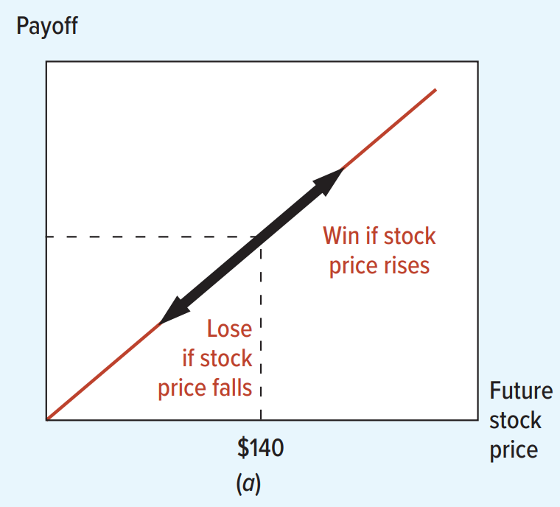
The Downside Protection Problem
Buy one Amazon share at $140
If price rises: you gain $1 for each $1 increase
If price falls: you lose $1 for each $1 decrease
Can we keep the upside but eliminate the downside?
Yes — using options!

Slide 21
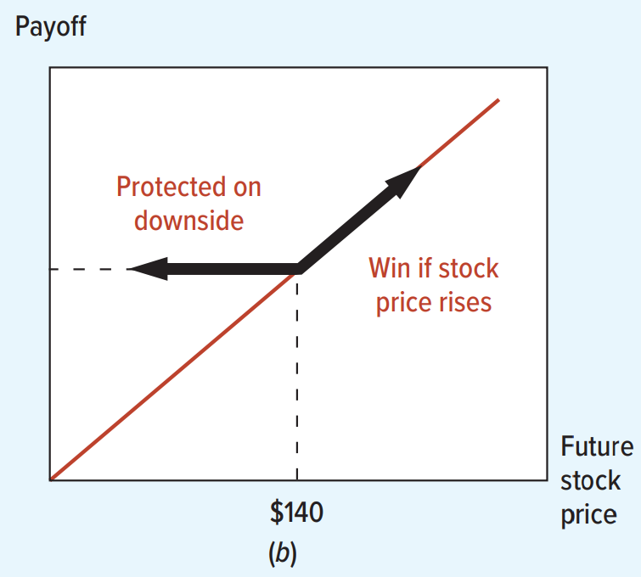
Downside Protection: The Protected Payoff
Strategy: buy share + buy put with X = $140
If S > $140: put is worthless, you keep all the upside
If S < $140: exercise the put, sell your share for $140
Payoff stays at $140 no matter how far the stock falls
Cost of protection: $11.50 (the price of the put option)

Slide 22
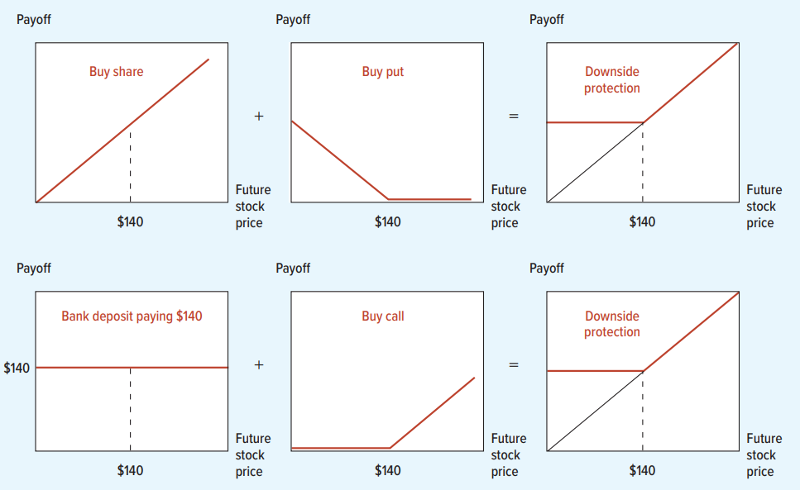
Two Ways to Create Downside Protection
Row 1: Buy share + buy put
Upside: keep stock gains (S)
Downside: put protects at X (X)
Row 2: Bank deposit + buy call
Deposit PV($140) in bank
Buy call with X = $140
Upside: call captures gains (S)
Downside: bank deposit pays $140 (X)
Both strategies give identical payoffs in all scenarios
Notes:
Portfolio A (Put Option + Share)
Scenario 1: The share price rises above the exercise price ($S > X$) Your put option is out of the money and expires worthless ($0$). You simply hold onto your share. Your total portfolio value is $S$.
Scenario 2: The share price falls below the exercise price ($S < X$) Your share is only worth $S$. However, your put option is in the money, guaranteeing you the right to sell that share for $X$. You exercise the put, making your total portfolio value $X$.
Portfolio B (Call Option + Bank Deposit)
Scenario 1: The share price rises above the exercise price ($S > X$) Your call option is in the money. You use the $X$ cash from your bank deposit to exercise the call and buy the share. You now own the share, so your total portfolio value is $S$
Scenario 2: The share price falls below the exercise price ($S < X$) Your call option is out of the money and expires worthless ($0$). However, your bank deposit has grown to exactly $X$. Your total portfolio value is $X$.
In both cases, initial outlay is PV($140) + cost of option.

Slide 23

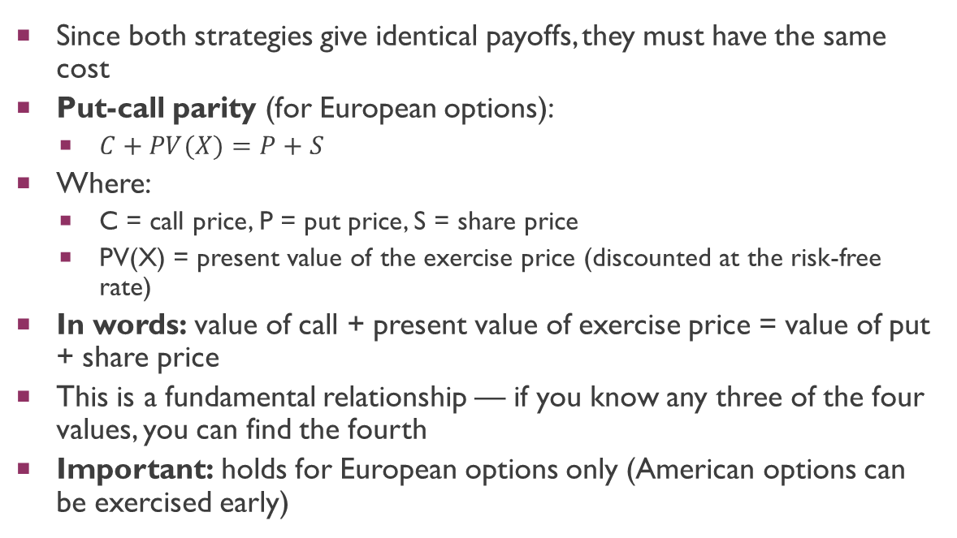
Put-Call Parity
Since both strategies give identical payoffs, they must have the same cost
Put-call parity (for European options):
$C+PV(X)=P+S$
Where:
C = call price, P = put price, S = share price
PV(X) = present value of the exercise price (discounted at the risk-free rate)
In words: value of call + present value of exercise price = value of put + share price
This is a fundamental relationship — if you know any three of the four values, you can find the fourth
Important: holds for European options only (American options can be exercised early)

Slide 24
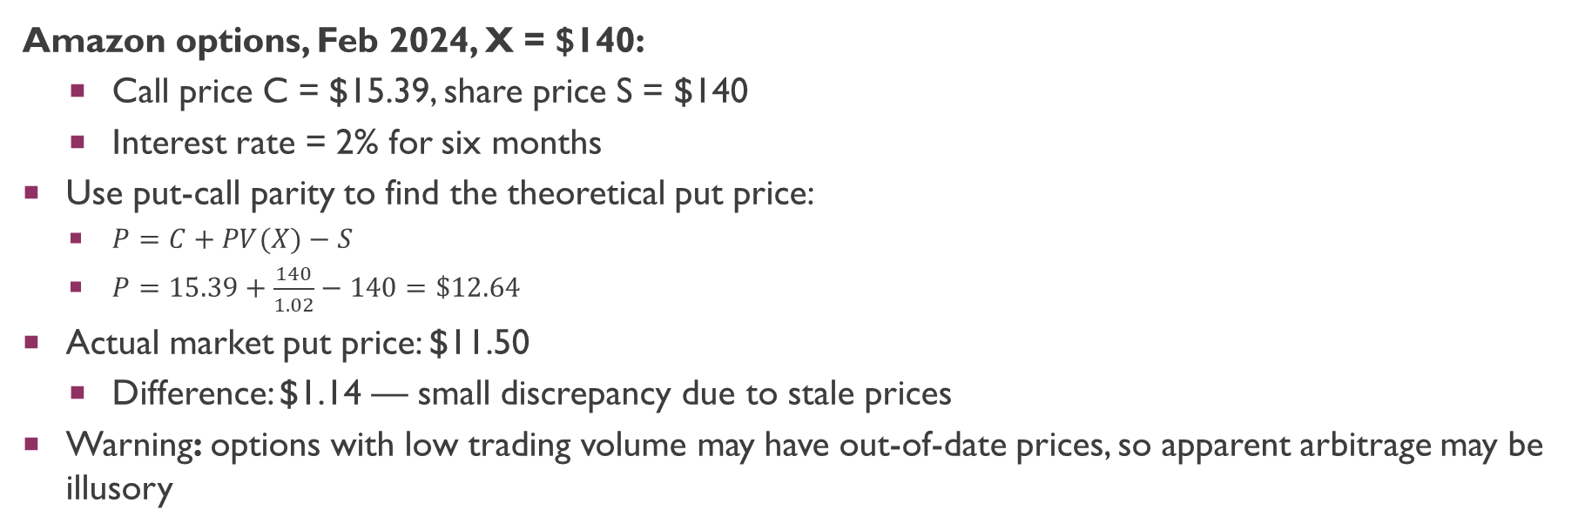
Put-Call Parity: Numerical Example
Amazon options, Feb 2024, X = $140:
Call price C = $15.39, share price S = $140
Interest rate = 2% for six months
Use put-call parity to find the theoretical put price:
$P=C+PV(X)−S$
$P=15.39+\frac{140}{1.02}−140=\$12.64$
Actual market put price: $11.50
Difference: $1.14 — small discrepancy due to stale prices
Warning: options with low trading volume may have out-of-date prices, so apparent arbitrage may be illusory
Notes:
Trading volume in many of these specific options is often very low. If the put option hasn't traded recently, its quoted "last price" (the $11.50) is an artifact from hours or even days ago.

Slide 25
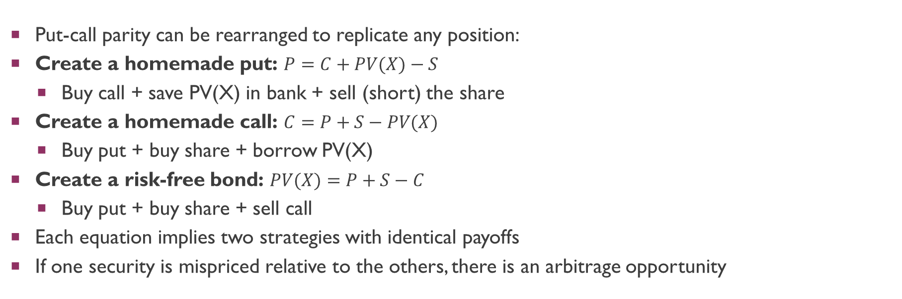
Rearranging Put-Call Parity
Put-call parity can be rearranged to replicate any position:
Create a homemade put: $P=C+PV(X)−S$
Buy call + save PV(X) in bank + sell (short) the share
Create a homemade call: $C=P+S−PV(X)$
Buy put + buy share + borrow PV(X)
Create a risk-free bond: $PV(X)=P+S−C$
Buy put + buy share + sell call
Each equation implies two strategies with identical payoffs
If one security is mispriced relative to the others, there is an arbitrage opportunity

Slide 26
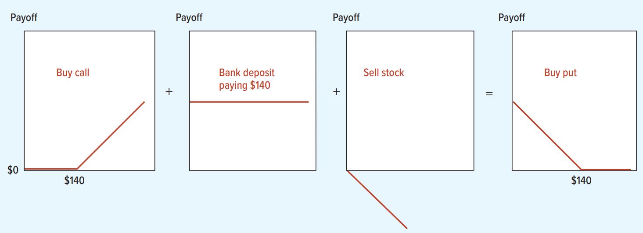
Replicating a Put Option
Buy call (X = $140) + deposit PV($140) in bank + sell (short) the stock
Example: S = $120 at maturity
Call = $0, bank = $140, cost to buy back (profits from shorting) = $120
Total = $20 = put payoff
Law of one price: if payoffs are identical, prices must be equal today

Slide 27

Spotting the Option: Ms. Higden’s Capped Bonus
Robots & Drones Corp. offers its president a bonus:
$50,000 for every $1 the stock price exceeds $120
Maximum bonus: $2,000,000 (cap at stock price = $160)
Think of this as 50,000 “tickets”, each paying:
$0 if S < $120
$1 for each $1 above $120, up to max of $40 (160-120)
How to replicate one ticket:
Buy a call with X = $120
Sell a call with X = $160
The purchase and sale together replicate the capped bonus payoff
Notes:
hose two positions interact at maturity across three different stock price scenarios:
If S <= 120: Both options are out of the money and expire worthless. Total payoff = $0.
If S = 140 (Between the strikes): The $120 call you bought is in the money and pays $20. The $160 call you sold is out of the money and worthless. Total payoff = $20.
If S = 180 (Above the cap): The $120 call you bought pays $60. However, the $160 call you sold is also in the money, meaning you owe the buyer $20 (180 - 160). Your net payoff is 60 - 20 = $40.

Slide 28
The Replication Principle
The Replication Principle:
Any set of contingent payoffs — payoffs that depend on the value of an underlying asset — can be replicated with a mixture of simple options on that asset
You can create any payoff diagram — with as many ups, downs, peaks, and valleys as you wish — by buying or selling puts and calls with different exercise prices
Financial engineering is the practice of packaging different investments to create new tailor-made instruments
A Peruvian company can cap its dollar purchase cost with options
A solar company can link its debt interest to electricity prices
Options are the essential building blocks for creating these structures

Slide 29
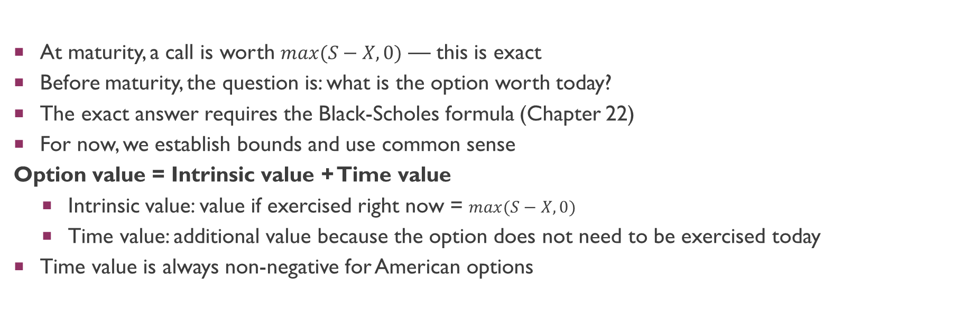
Option Value Before Maturity
At maturity, a call is worth $max(S−X,0)$ — this is exact
Before maturity, the question is: what is the option worth today?
The exact answer requires the Black-Scholes formula (Chapter 22)
For now, we establish bounds and use common sense
Option value = Intrinsic value + Time value
Intrinsic value: value if exercised right now = $max(S−X,0)$
Time value: additional value because the option does not need to be exercised today
Time value is always non-negative for American options
Notes:
The Lower Bound (Intrinsic Value): The absolute lowest price a call option can trade for is its value if you were to exercise it right now. For a call, this is $max(S-X,0)$. If an option's price fell below this intrinsic value, an arbitrageur could simply buy the cheap option, immediately exercise it to buy the stock at the strike price, and sell the stock in the open market for a risk-free profit. Therefore, market forces prevent the price from dropping below this floor.
The Upper Bound: This one is simple: a call option can never be worth more than the underlying share itself. Why? Because the absolute best-case scenario for a call option is that it allows you to acquire the share. No one would pay more for the right to buy a share than it costs to just buy the share outright.

Slide 30
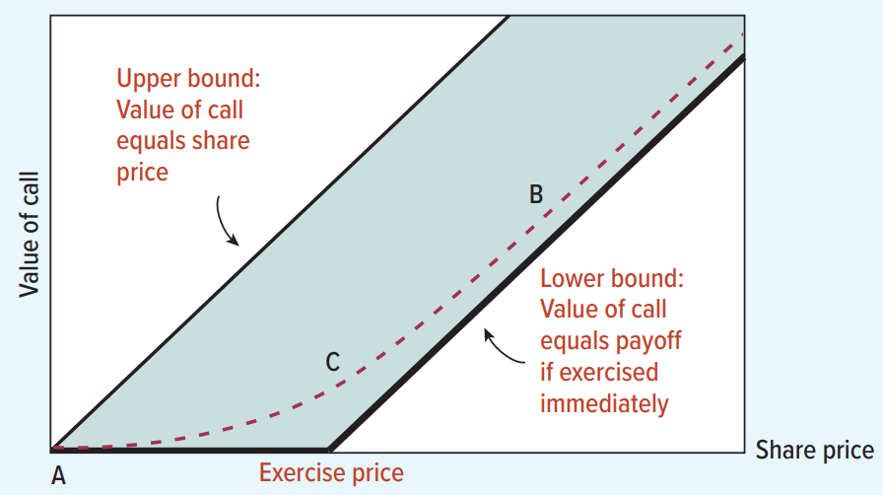
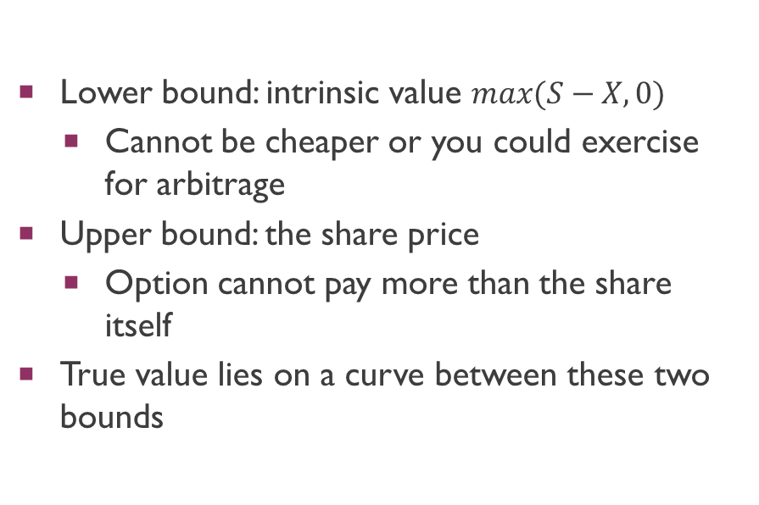
Bounds on the Value of a Call
Lower bound: intrinsic value $max(S−X,0)$
Cannot be cheaper or you could exercise for arbitrage
Upper bound: the share price
Option cannot pay more than the share itself
True value lies on a curve between these two bounds
Notes:
The Lower Bound (Intrinsic Value): The absolute lowest price a call option can trade for is its value if you were to exercise it right now. For a call, this is $max(S-X,0)$. If an option's price fell below this intrinsic value, an arbitrageur could simply buy the cheap option, immediately exercise it to buy the stock at the strike price, and sell the stock in the open market for a risk-free profit. Therefore, market forces prevent the price from dropping below this floor.
The Upper Bound: This one is simple: a call option can never be worth more than the underlying share itself. Why? Because the absolute best-case scenario for a call option is that it allows you to acquire the share. No one would pay more for the right to buy a share than it costs to just buy the share outright.

Slide 31
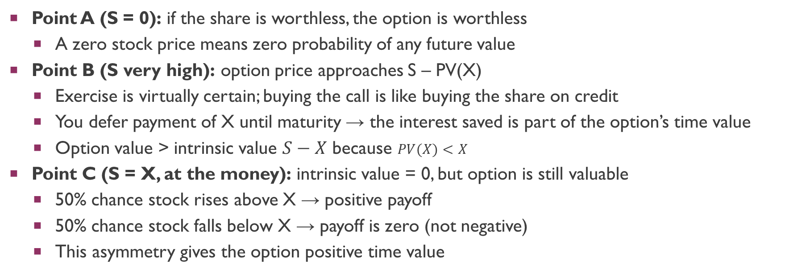
Understanding the Option Value Curve
Point A (S = 0): if the share is worthless, the option is worthless
A zero stock price means zero probability of any future value
Point B (S very high): option price approaches S – PV(X)
Exercise is virtually certain; buying the call is like buying the share on credit
You defer payment of X until maturity → the interest saved is part of the option’s time value
Option value > intrinsic value $S−X$ because $PV(X)<X$
Point C (S = X, at the money): intrinsic value = 0, but option is still valuable
50% chance stock rises above X → positive payoff
50% chance stock falls below X → payoff is zero (not negative)
This asymmetry gives the option positive time value

Slide 32
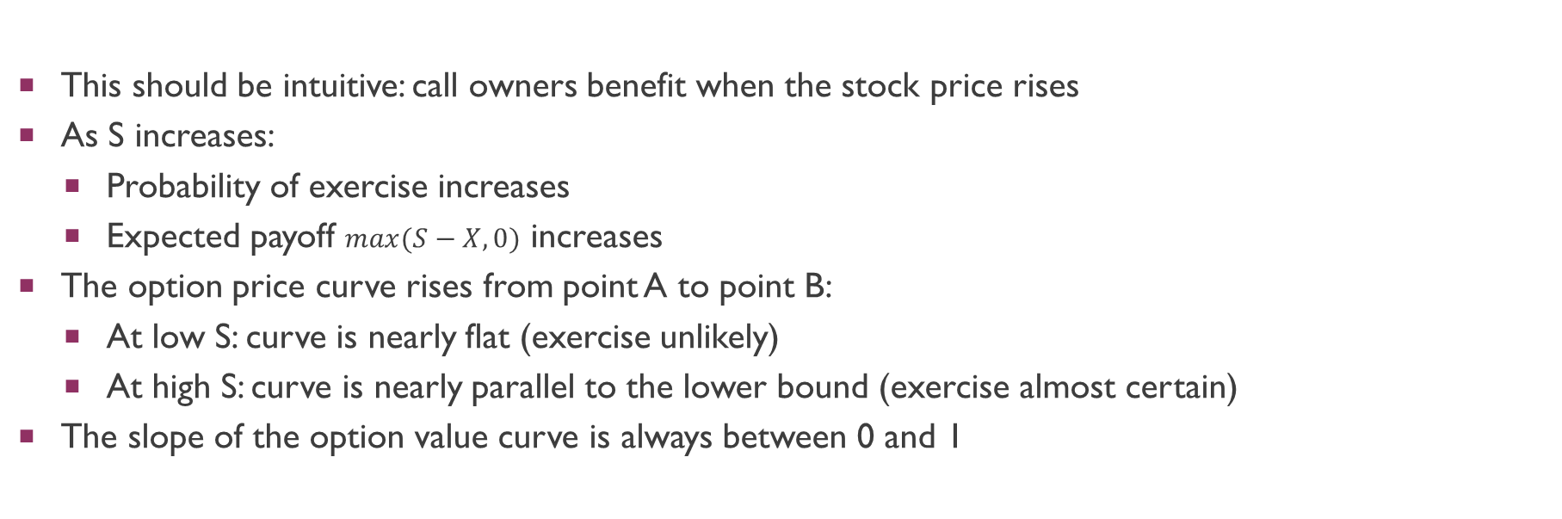
Call Value Increases with Share Price
This should be intuitive: call owners benefit when the stock price rises
As S increases:
Probability of exercise increases
Expected payoff $max(S−X,0)$ increases
The option price curve rises from point A to point B:
At low S: curve is nearly flat (exercise unlikely)
At high S: curve is nearly parallel to the lower bound (exercise almost certain)
The slope of the option value curve is always between 0 and 1

Slide 33
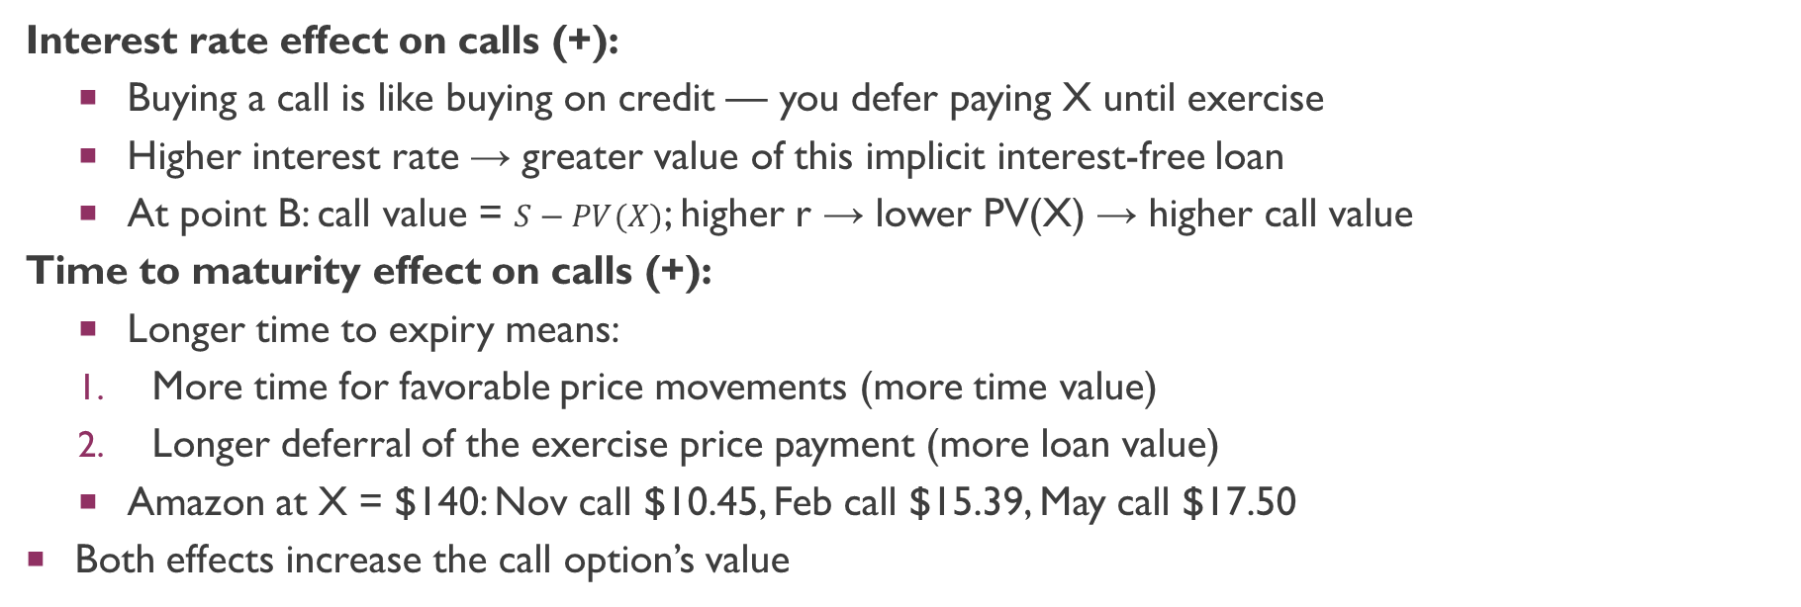
Interest Rate and Time to Maturity
Interest rate effect on calls (+):
Buying a call is like buying on credit — you defer paying X until exercise
Higher interest rate → greater value of this implicit interest-free loan
At point B: call value = $S−PV(X)$; higher r → lower PV(X) → higher call value
Time to maturity effect on calls (+):
Longer time to expiry means:
More time for favorable price movements (more time value)
Longer deferral of the exercise price payment (more loan value)
Amazon at X = $140: Nov call $10.45, Feb call $15.39, May call $17.50
Both effects increase the call option’s value
Notes:
Buying a call is effectively buying the underlying stock on credit. The longer you can delay handing over the cash to pay the exercise price (X), the greater the present value of those interest savings.

Slide 34
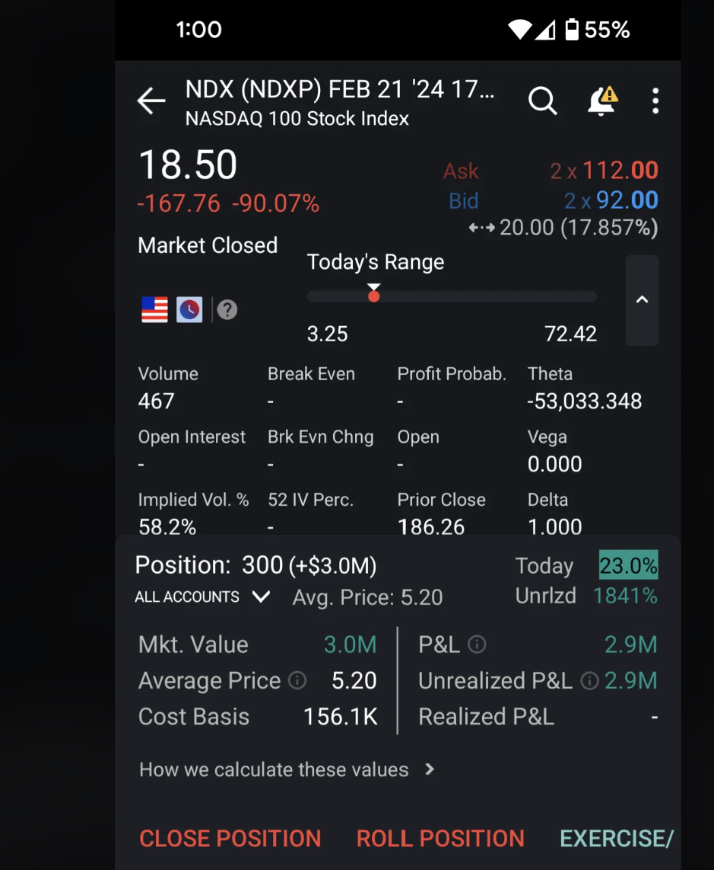
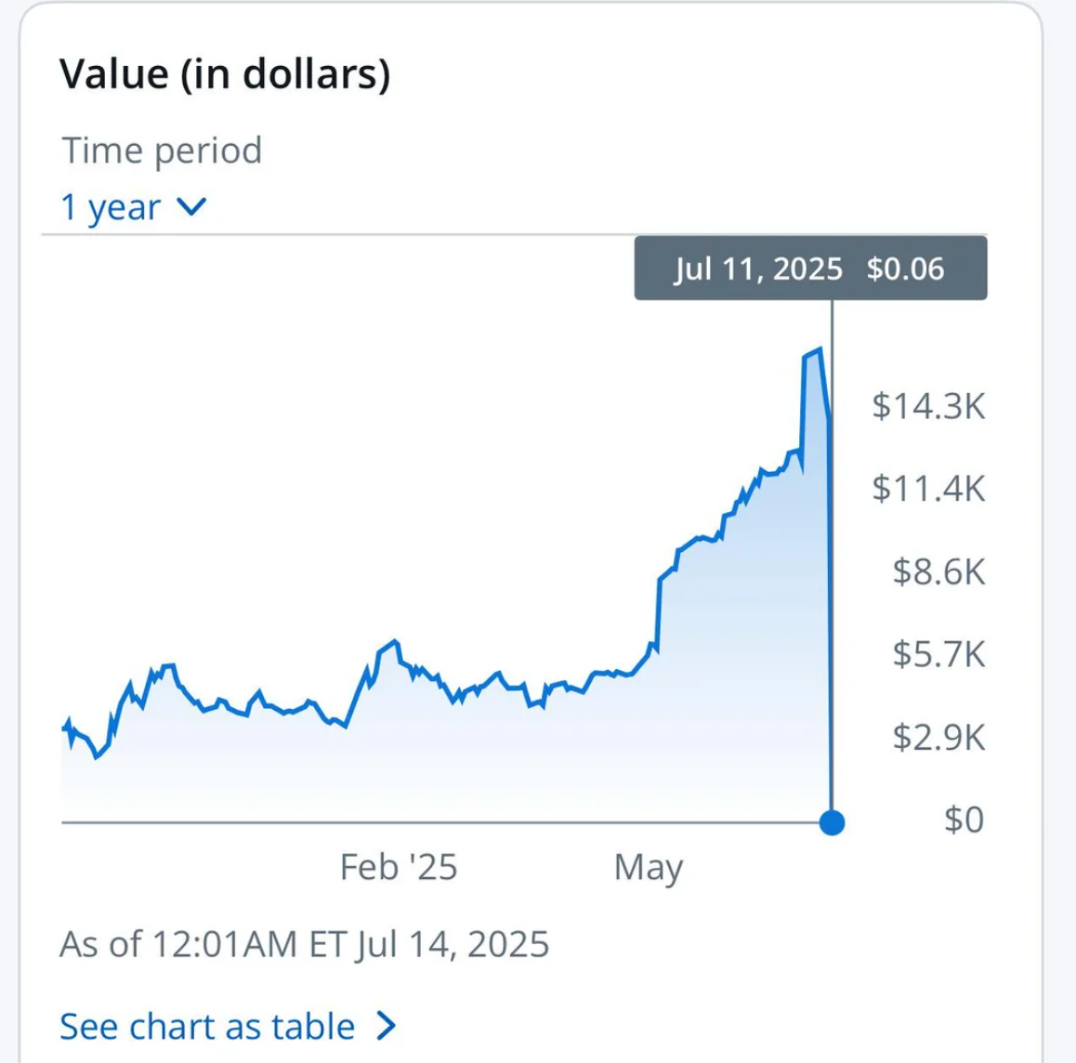
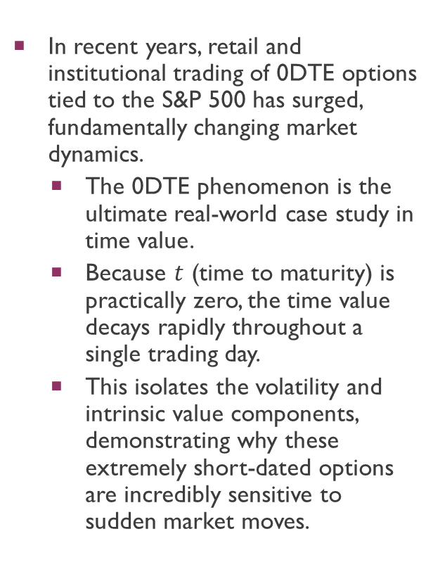
The Rise of 0DTE (Zero-Days-To-Expiration) Options
In recent years, retail and institutional trading of 0DTE options tied to the S&P 500 has surged, fundamentally changing market dynamics.
The 0DTE phenomenon is the ultimate real-world case study in time value.
Because $t$ (time to maturity) is practically zero, the time value decays rapidly throughout a single trading day.
This isolates the volatility and intrinsic value components, demonstrating why these extremely short-dated options are incredibly sensitive to sudden market moves.

Slide 35
Volatility: Why Risk Is Good for Options
In most finance settings, higher risk = lower value (you must be compensated)
For options, it’s the opposite: higher volatility = higher value
The key is asymmetric payoffs:
If S falls below X, the option is worthless — whether S is $1 or $100 below X
If S rises above X, the call gains $1 for every $1 above X
The option holder gains from upside volatility but does not lose more on the downside
Analogy: you have a floor on losses (zero) but no ceiling on gains
An option on a share that may halve or double is far more valuable than one on a share that moves by 1%

Slide 36
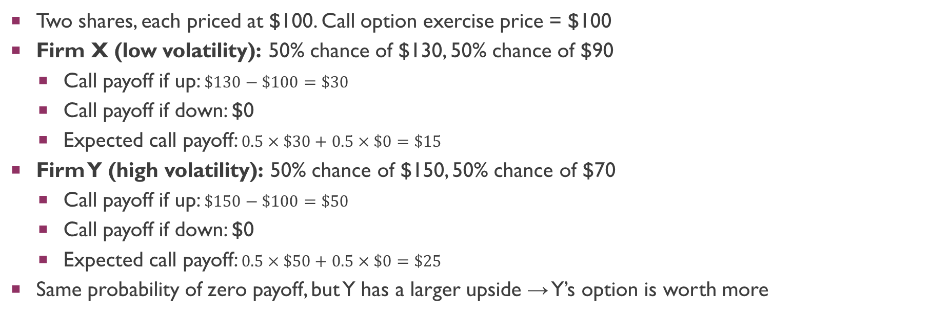
Volatility Example: Firm X vs. Firm Y
Two shares, each priced at $100. Call option exercise price = $100
Firm X (low volatility): 50% chance of $130, 50% chance of $90
Call payoff if up: $\$130−\$100=\$30$
Call payoff if down: $0
Expected call payoff: $0.5×\$30+0.5×\$0=\$15$
Firm Y (high volatility): 50% chance of $150, 50% chance of $70
Call payoff if up: $\$150−\$100=\$50$
Call payoff if down: $0
Expected call payoff: $0.5×\$50+0.5×\$0=\$25$
Same probability of zero payoff, but Y has a larger upside → Y’s option is worth more

Slide 37
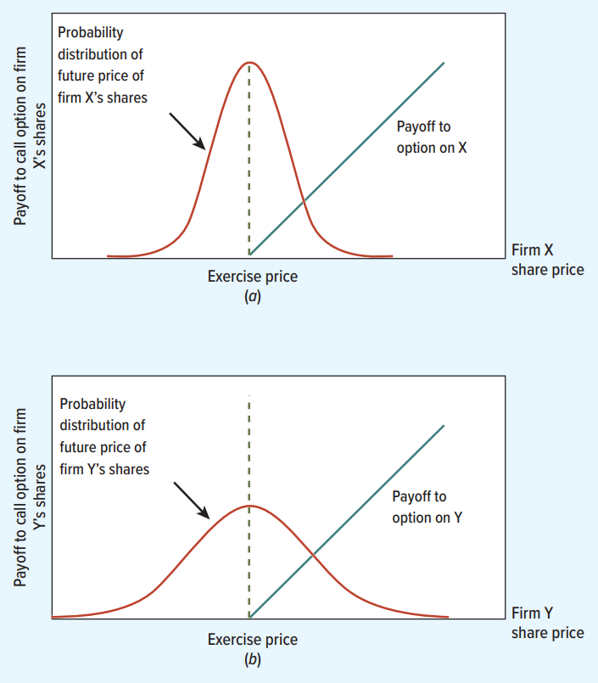
Volatility and the Probability Distribution
Firm Y has a wider distribution of future share prices
Greater spread = more upside potential for the option
Firm X: narrow distribution, small chance of large payoff
Firm Y: wide distribution, bigger chance of large payoff
Both have same probability of ending worthless (50%)

Slide 38
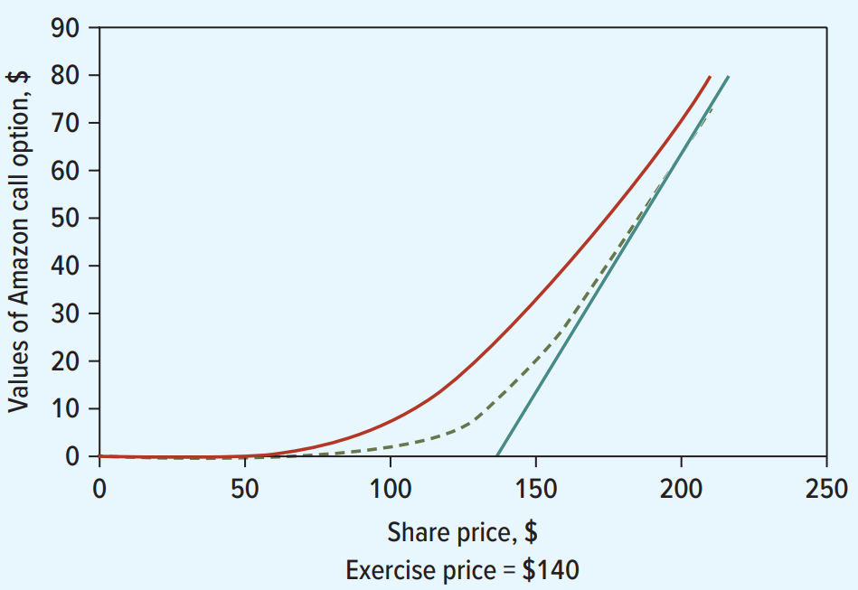
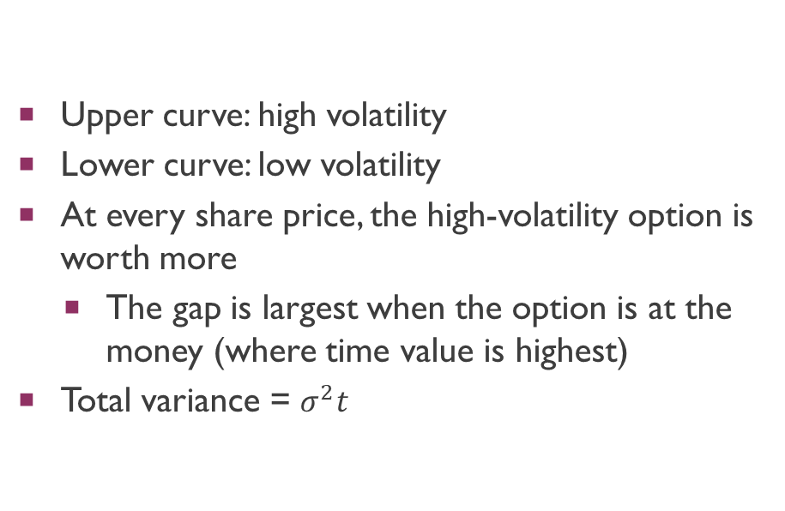
Effect of Volatility on Call Value
Upper curve: high volatility
Lower curve: low volatility
At every share price, the high-volatility option is worth more
The gap is largest when the option is at the money (where time value is highest)
Total variance = $σ^{2}t$
Notes:
stock prices follow a "random walk," meaning that each successive change in the stock's price is statistically independent of the last.. if $\sigma^2$ is the variance of a stock's daily price change, and there are $t$ days remaining until the option expires, the total variance of the cumulative price change over that entire period is simply $\sigma^2$ added to itself $t$ times, which equals $\sigma^2 t$.
When an option is right at the money, it is sitting on a knife's edge. Its intrinsic value is zero, and there is roughly a 50% chance the stock will rise (making the option valuable) and a 50% chance it will fall (making the option worthless). However, an option is deep in the money (far to the right on the chart), it acts almost exactly like the underlying stock itself, so extra volatility doesn't add much unique value. If it is deep out of the money (far to the left on the chart), it is so far away from the strike price that even a highly volatile stock is unlikely to bridge the gap before expiration.

Slide 39

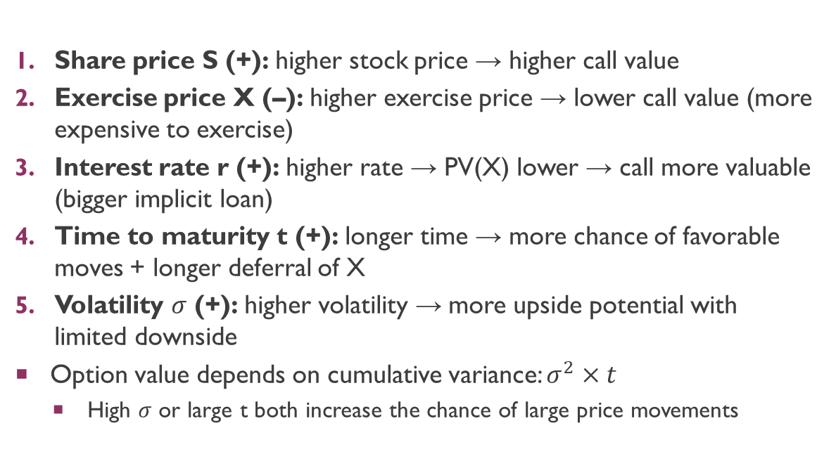
Five Determinants of Call Option Value
Share price S (+): higher stock price → higher call value
Exercise price X (–): higher exercise price → lower call value (more expensive to exercise)
Interest rate r (+): higher rate → PV(X) lower → call more valuable (bigger implicit loan)
Time to maturity t (+): longer time → more chance of favorable moves + longer deferral of X
Volatility $σ$ (+): higher volatility → more upside potential with limited downside
Option value depends on cumulative variance: $σ^{2}×t$
High $σ$ or large t both increase the chance of large price movements

Slide 40
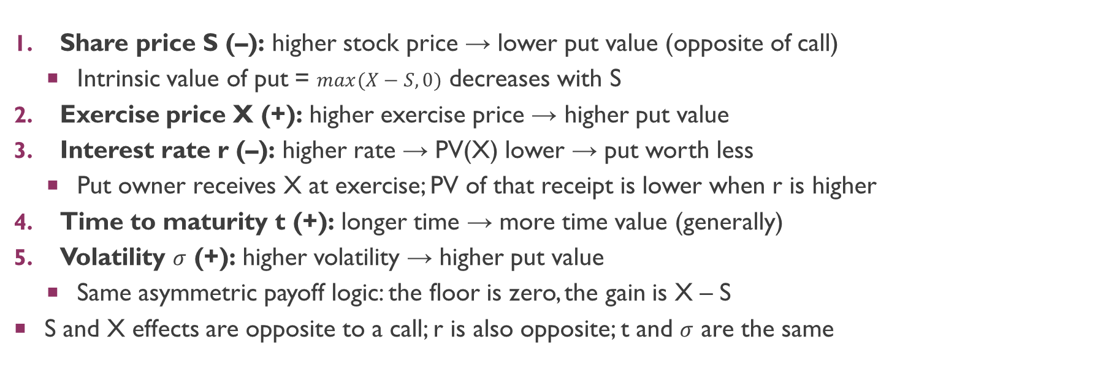
Determinants of Put Option Value
Share price S (–): higher stock price → lower put value (opposite of call)
Intrinsic value of put = $max(X−S,0)$ decreases with S
Exercise price X (+): higher exercise price → higher put value
Interest rate r (–): higher rate → PV(X) lower → put worth less
Put owner receives X at exercise; PV of that receipt is lower when r is higher
Time to maturity t (+): longer time → more time value (generally)
Volatility $σ$ (+): higher volatility → higher put value
Same asymmetric payoff logic: the floor is zero, the gain is X – S
S and X effects are opposite to a call; r is also opposite; t and $σ$ are the same

Slide 41
Risk and Option Values: A Counterintuitive Result
In most of finance, higher risk = lower value (you demand a risk premium)
For options, higher risk = HIGHER value
Why? Options give the holder a one-way bet:
You exercise if the outcome is favorable
You walk away if it is not
Your loss is capped at the premium paid
More risk (volatility) increases the probability of extreme outcomes
Extreme positive outcomes increase your payoff
Extreme negative outcomes do not hurt you further (payoff is already zero)
Always remember: an option on a risky asset is worth more than an option on a safe asset

Slide 42
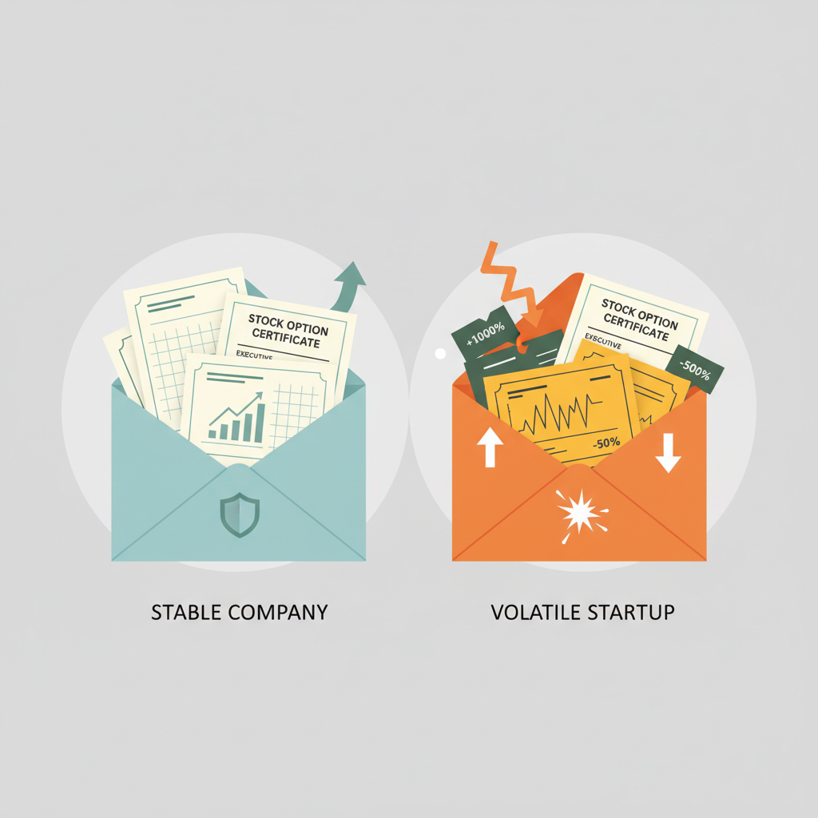
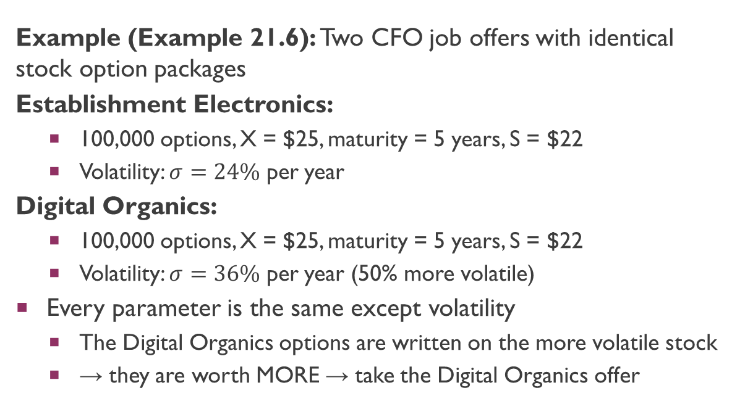
Executive Stock Options: Risk Is Good!
Example (Example 21.6): Two CFO job offers with identical stock option packages
Establishment Electronics:
100,000 options, X = $25, maturity = 5 years, S = $22
Volatility: $σ=24\%$ per year
Digital Organics:
100,000 options, X = $25, maturity = 5 years, S = $22
Volatility: $σ=36\%$ per year (50% more volatile)
Every parameter is the same except volatility
The Digital Organics options are written on the more volatile stock
→ they are worth MORE → take the Digital Organics offer

Slide 43
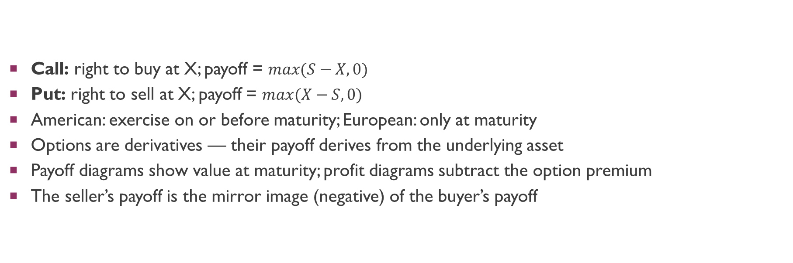
Key Takeaways: Calls and Puts
Call: right to buy at X; payoff = $max(S−X,0)$
Put: right to sell at X; payoff = $max(X−S,0)$
American: exercise on or before maturity; European: only at maturity
Options are derivatives — their payoff derives from the underlying asset
Payoff diagrams show value at maturity; profit diagrams subtract the option premium
The seller’s payoff is the mirror image (negative) of the buyer’s payoff

Slide 44
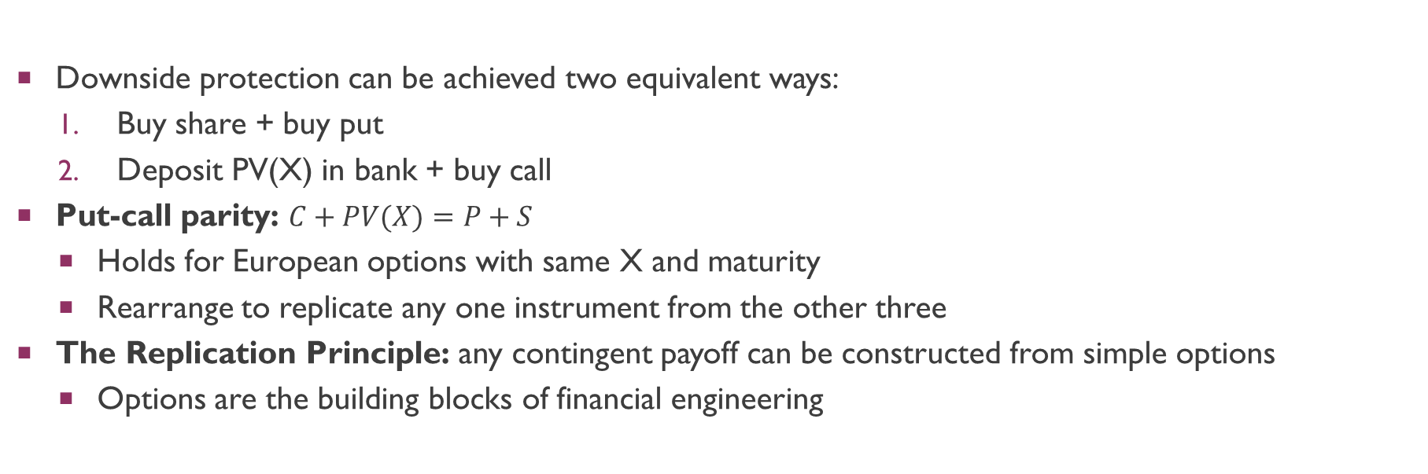
Key Takeaways: Financial Engineering
Downside protection can be achieved two equivalent ways:
Buy share + buy put
Deposit PV(X) in bank + buy call
Put-call parity: $C+PV(X)=P+S$
Holds for European options with same X and maturity
Rearrange to replicate any one instrument from the other three
The Replication Principle: any contingent payoff can be constructed from simple options
Options are the building blocks of financial engineering

Slide 45
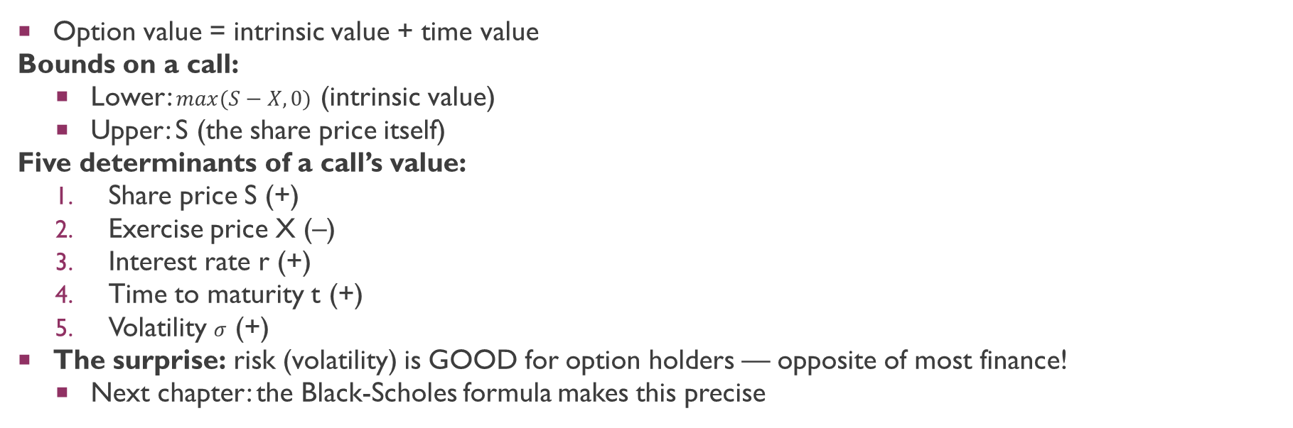
Key Takeaways: What Determines Option Values?
Option value = intrinsic value + time value
Bounds on a call:
Lower: $max(S−X,0)$ (intrinsic value)
Upper: S (the share price itself)
Five determinants of a call’s value:
Share price S (+)
Exercise price X (–)
Interest rate r (+)
Time to maturity t (+)
Volatility $σ$ (+)
The surprise: risk (volatility) is GOOD for option holders — opposite of most finance!
Next chapter: the Black-Scholes formula makes this precise

